Slide 1
Team O’s Scrum
By: winston, Koh Win, Jerryl, Anthony
https://docs.google.com/spreadsheets/d/1dYGlCp6nEL0flNYEZ-WvwxUotrGWr8_Fnbx5TQ8Orjo/edit?usp=sharing

Slide 2
Product Vision
For ages 7+
Who enjoys simplistic gameplay,
Bloons TD6 is a Tower defence game centred on monkey popping balloons,
That has colorful & bright aesthetics 3D graphics
Unlike most Tower Defence games,
our product has multiplatform and multiplayer capabilities

Slide 3
Project Team Structure
Product owner: Winston
Scrum master: Kohwin
Development team:
Designers: Barry, Larry, Jerryl
Developers: Kohwin, Winston, Anthony

Slide 4
User Stories, Epics, Theme
Jerryl:
As a casual gamer, I want a game which reward hard work and effort, so that i can feel accomplished
As a student, I want to play a game which I can play in the background so that i can focus on studying
As a working adult, i want to play some less intense games so that i can relax from my work
As a competitive gamer, I want to see High damage numbers and overpower the enemy so that i can feel satisfied.
As an Artist, i want to be able to create my own maps
Kohwin:
As a gamer who willingly spends money, I want a game which will allow me to get progress faster when i spend.
As a parent concerned for my child playing violent video games, I want a game that can provide entertainment to my child while also being family friendly.
As an adult with little time to play, i want a game that I can idle for a bit while doing other tasks like housework
As a poor person, i want a game that I am able to play on my low spec computer.
As a mobile gamer, I want a game that can crossplay so i can play with my friends on PC

Slide 5
User Stories, Epics, Theme
Anthony:
As a person who is colorblind I would like more accessibility options in the game.
As a social gamer I would like to be able to play the game with my friends.
As a gamer who values their time I want the game to have permanent rewards that makes me feel like sending time on the game was worth.
As a gamer I would like to be able to customise my UI to better suit me.
As a casual gamer I want a system that would advise me what to do to beat the level.
Winston:
As a person seeking challenge, i wish to have a ramping difficulty growth for harder challenges as the game progresses, so that i feel challenge growing over time.
As a casual gamer, i want to have simple and intuitive controls so that i can get into the game quickly and spend less time going over basics.
As an strategy gamer, i want to explore tower paths, so that i can experiment with effective builds.
As an achiever, i want to discover and gain achievements to flaunt and show my hard work.
As a person with short attention span, i want to ve able to keep save files and return to them whenever i want.

Slide 6
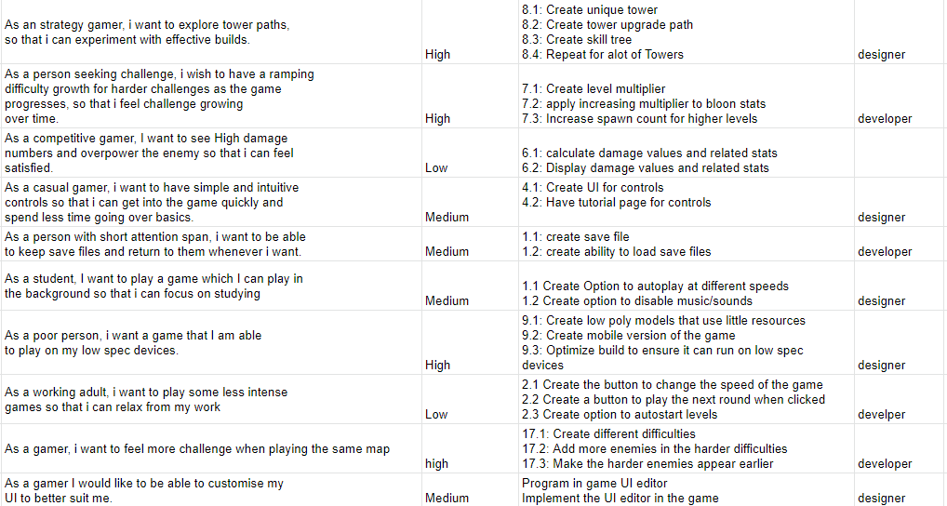
Product Backlog

Slide 7
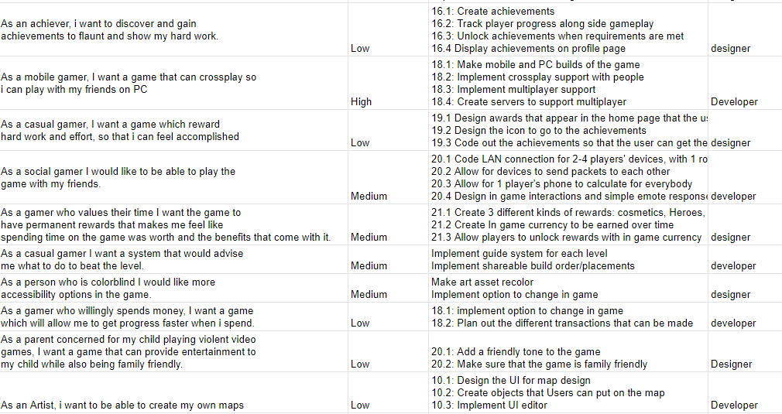
Product Backlog

Slide 8
Sprint 1

Slide 9
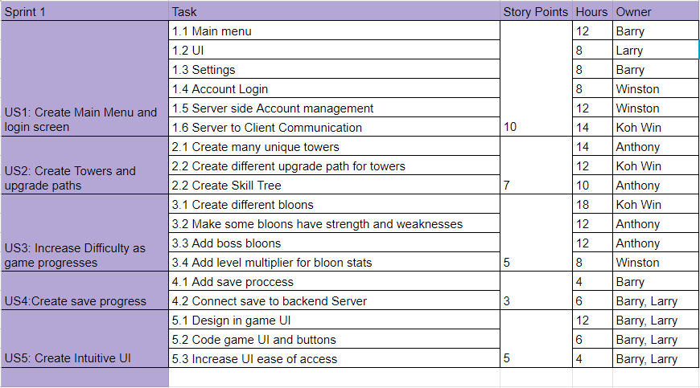
Project Backlog/Sprint Planning-1

Slide 10
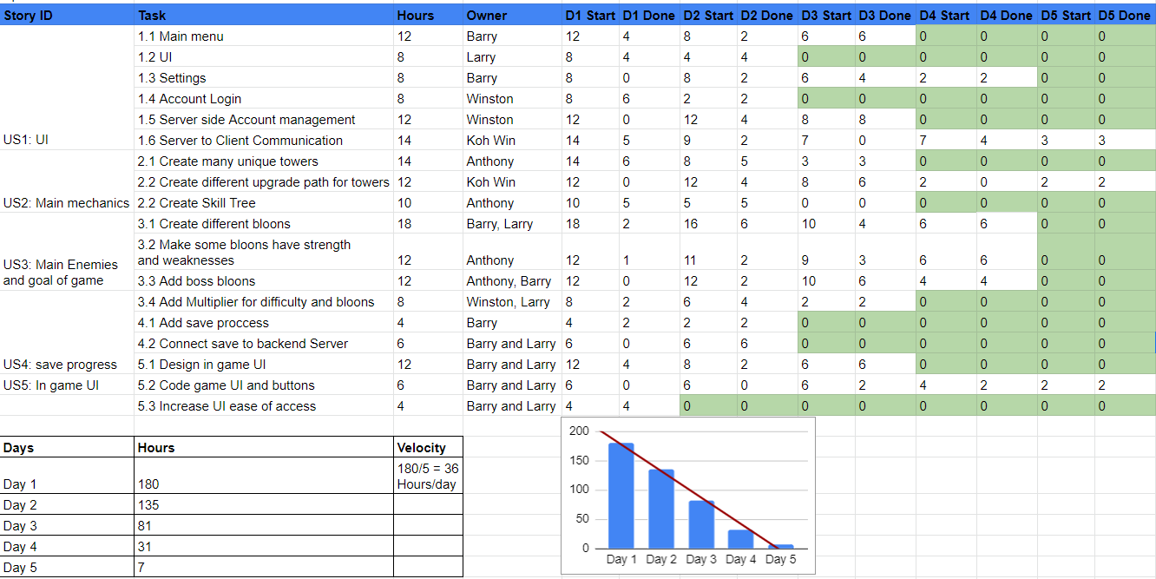

Slide 11
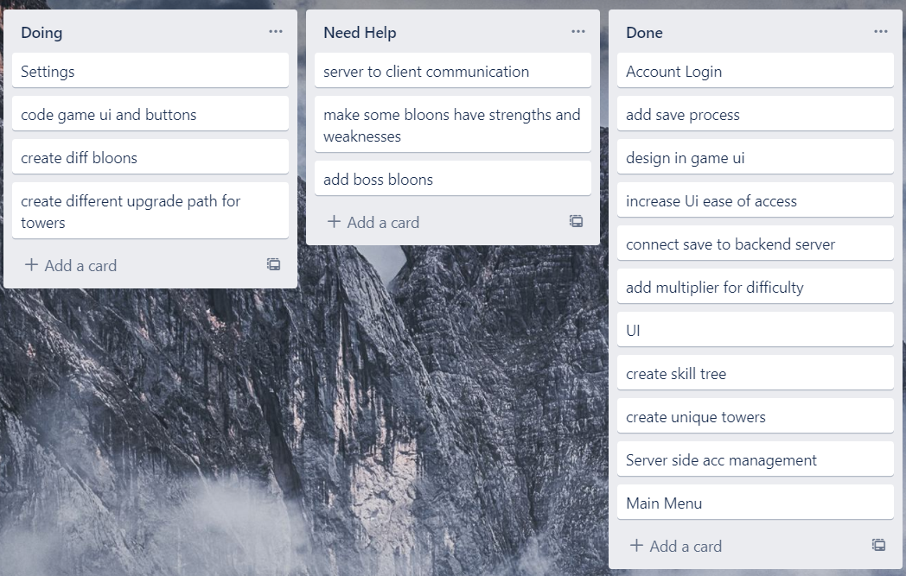
Task Board

Slide 12
Stand Meeting Notes
Day 1, I Got started on the Main menu
, got good progress on that. Did a touch
of save progress until larry required help for
coding the in game Ui. Ill continue doing the
main menu tomorrow, start on the settings and
probably help out larry a little more. There is
a bug with the settings where it doesnt display
if you change your aspect ratio. - Barry
Day 2, i spent most of my day fixing server side
issues and trying to get this login system to function.
Then Larry needed help so i did the miltiplier with him
for a bit. Will try an finish fixing server issues tomorrow. - Winston
Day 3, Spent the entire day working on boss bloons
and their multipliers with Barry. I will move on to making
them have strengths and weaknesses tomorrow.
Found out a bug where the 2nd boss will not spawn
the correct amount of bloons when killed
on the hard difficulty specifically. - Anthony
Day 4, Finally finished the settings and different bloon types.
Now all thats left is the UI button coding. It shouldnt take too long. - Barry

Slide 13
Sprint Review
Increment: The first sprint and all it's tasks assigned were completed on time.
Feedback: The product is delivered well, with little flaws.

Slide 14
Sprint Retrospective
What went well:
Even though there was a roadblock, we quickly navigated around it to finish the sprint on time.
What did not go so well:
Winston had to take a little extra time solving backend server issues, but other than that everything went fine,
Things that can be improved:
Our speed of doing tasks for the first sprint was slow due to the large number of backend server sided bugs that were present

Slide 15
Sprint 2

Slide 16
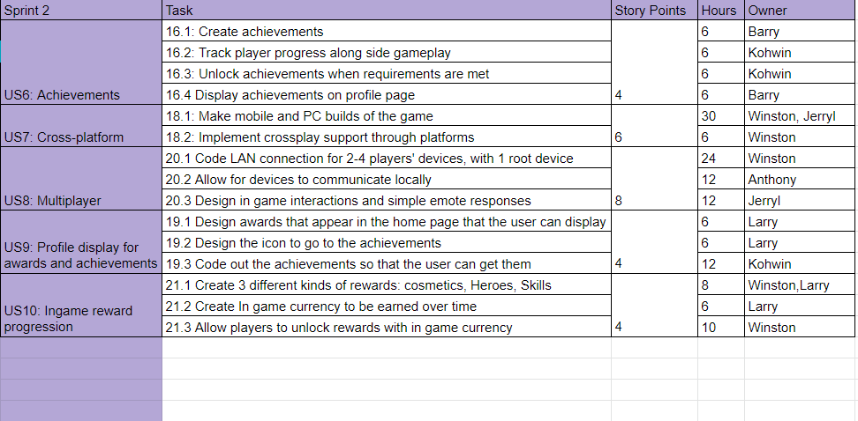
Project Backlog/Sprint Planning-2

Slide 17
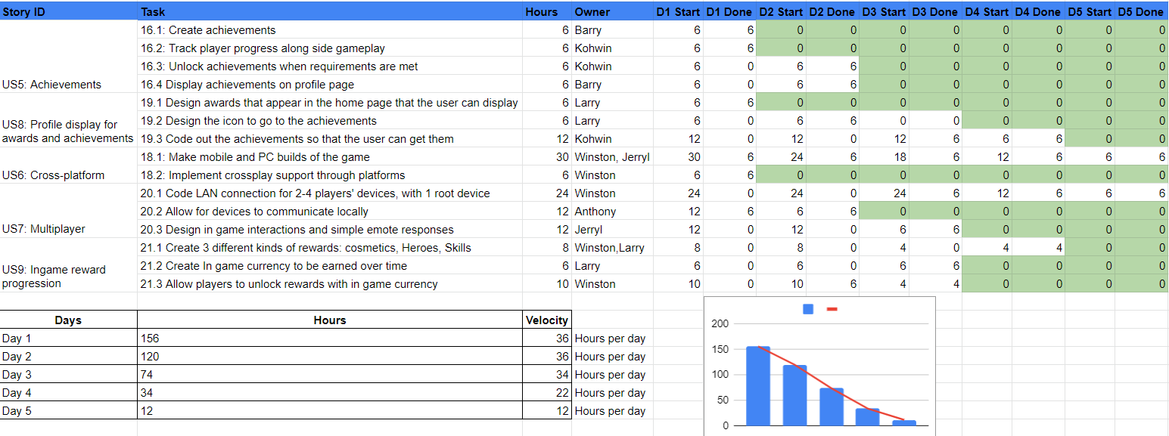

Slide 18
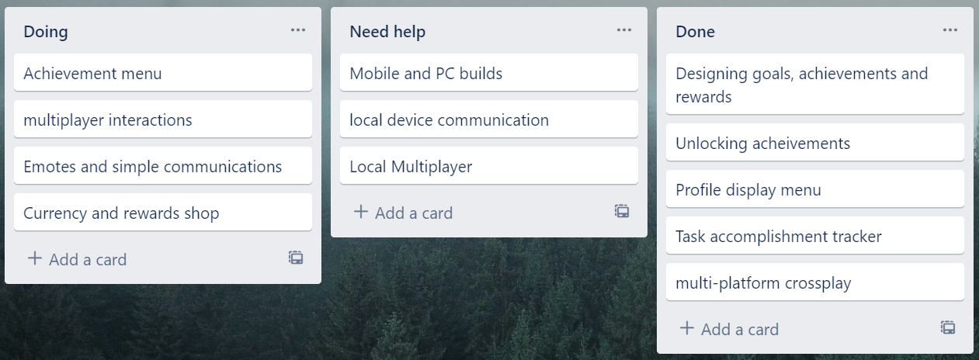
Task Board

Slide 19
Stand Meeting Notes
Day 1: I started implementing achievements and communicating with the team on what are some achievable goals that players can get. Which led to some bugs being found. This pushed back the schedule due to added time needed to fix bugs - Koh win
Day 2: I worked with Jerryl today to port most of the game from PC to mobile, no major issues were found though the work was pretty slow for the majority of the day, barely finishing on time- Winston
Day 3: In game Emotes are harder to design than it looks, I am on track with animations and I think i'll be done early today- Jerryl
Day 4: I have finished with in game rewards and their corresponding effects, might need some more time with debugging and polishing, but other than that, im done with my tasks- Larry

Slide 20
Sprint Review
Increment: 2nd sprint and product increment completed ahead of time.
Feedback: The product was well made and in playable condition, few bug detected in the current build. Early access publication is allowed.

Slide 21
Sprint Retrospective
What went well:
Even though there was a roadblock, we quickly navigated around it to finish the sprint on time.
What did not go so well:
Winston had to take a little extra time solving backend server issues, but other than that everything went fine,
Things that can be improved:
Our speed of doing tasks for the sprint was slow due to the large number of backend server sided bugs that were present

Slide 22
Sprint 3

Slide 23
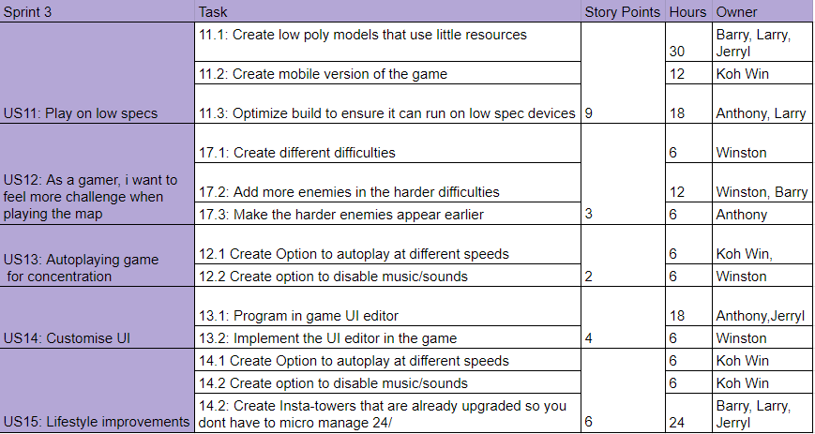
Project Backlog/Sprint Planning

Slide 24
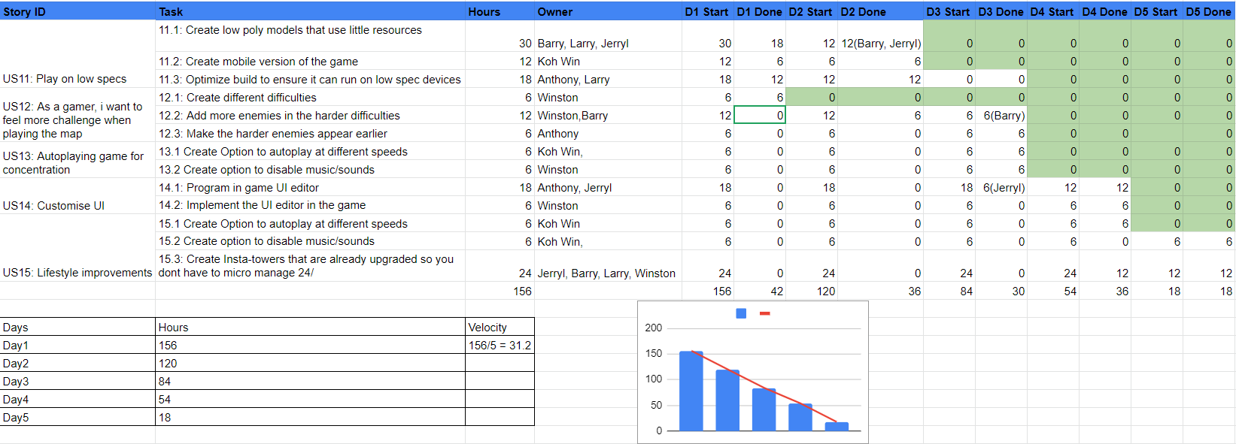

Slide 25
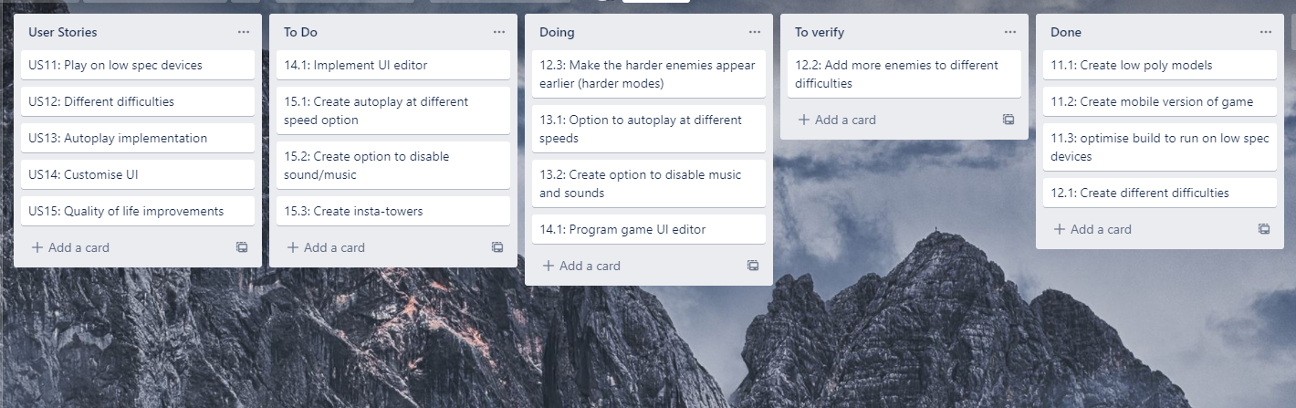
Task Board

Slide 26
Stand Meeting Notes
Day2: The previous day, i designed some of the low poly models with Larry and Barry, later i am going to finish the low poly models with Barry. There were no problems so far. ~ Jerryl
Day3: The previous day I was optimising the build with Larry to run on low spec devices, later i am going to program the game so harder enemies appear in different difficulties. So far i have no issues. ~ Anthony
Day4: I was sick so i couldn’t do anything the previous day, I am going to help create insta-towers with Barry, larry and Winston. ~ Larry
Day5: I was coding in and testing the option to autoplay at different speeds, today i will create and test the option to disable musics and all sounds. There was a small issue which made me spend more time than needed on it but it was fixed and done. ~ Koh Win

Slide 27
Sprint Review
Increment: All tasks in sprint 3 added, and applied into the product.
Feedback: The functions are mostly well implemented, but I do not know how to play the game, so i want you to add some sort of guide system in during your next sprint.

Slide 28
Sprint Retrospective
What went well:
Everyone was on task and task were completed quickly even though there was a delay.
Issues were solved very quickly
What did not go so well:
Koh Win unfortunately faced some issues with code nearing the end of the sprint which delayed the end a little bit.
Things that can be improved:
The team can communicate more with other members so that some members do not get left waiting for others to finish their tasks

Slide 29
Sprint 4

Slide 30
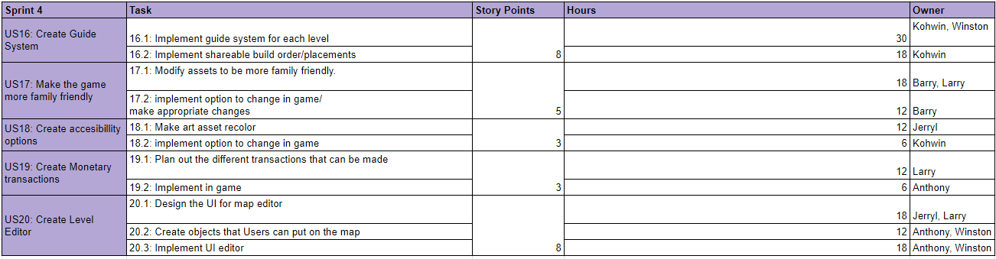
Project Backlog/Sprint Planning

Slide 31
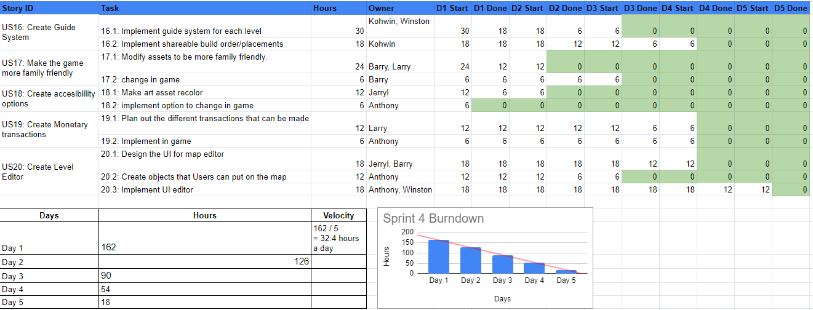

Slide 32
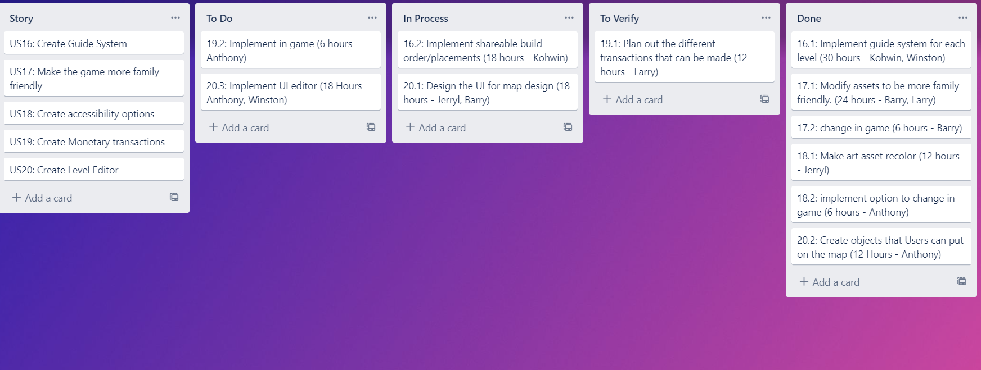
Task Board - Sprint 4

Slide 33
Daily Stand Meeting Notes
Day 2: I have implemented the option to change the art assets in game to different ones in game(just replace image to update with new art assets). I am going to start implementing some of our assets to work with the eventual level editor. I have encountered no problems. ~ Anthony
Day 3: I have Finished making the more family friendly assets with Larry. I am going to start putting it in game. When making the assets it was difficult to find and replace all assets that were not family friendly. ~Barry
Day 4: I have made some progress in designing the ui for our level editor. I am going to consult with Barry and continue working on it. It was difficult to make the design decisions to make the UI as user friendly as possible. ~ Jerryl
Day 5: I have made some progress on implementing the UI editor into the game. I am going to get Anthony caught up with what I have done, decide what to do, and finish up the level editor. I had difficulty with implementing the level sharing system.

Slide 34
Sprint Review
Increment: All features are of more higher quality than last sprint.
Feedback: Maybe try to allocate work time between members better to speed up the sprint.

Slide 35
Retrospective
What went well:
Everything was done on time and we suffered little delays.
What did not go well:
The implementation of the level editor was close to exceeding the deadline.
Things to improve:
Better allocation of tasks

Slide 36
Time Boxing Methods
Daily Stand Meeting | Scrum Planning | Sprint Review | Sprint Retrospective
15 min | 2 Hours (Beginning of sprint) | 1 Hour | 1 Hour
Daily | Once per sprint | Once per sprint | Once per sprint
4 Sprints | 4 Sprints | 4 Sprints | 4 Sprints

Slide 37
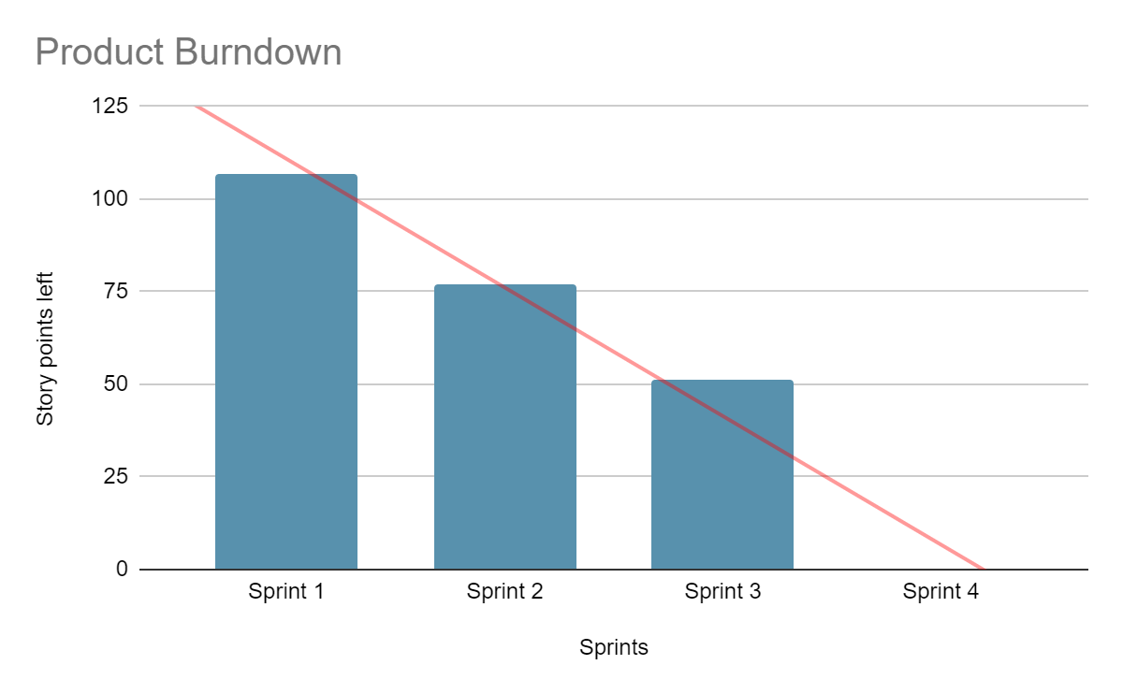
Product Burndown Chart
Sprints | Story points done | Story points left
Sprint 1 | 30 | 107
Sprint 2 | 26 | 77
Sprint 3 | 24 | 51
Sprint 4 | 27 | 0

Slide 38
Other Insights
Pros of Scrum:
Large projects are divided into easily manageable sprints
The team gets clear visibility through scrum meetings
Scrum, being agile, adopts feedback from customers and stakeholders
Cons of Scrum:
No definite due date leads to scope creep
Very difficult to execute for large teams
Scrum Values:
The five Scrum values are commitment, focus, openness, respect, and courage.
The SCRUM guide focuses on user proficiency with these values, to promote the efficiency of using SCRUM.

Slide 39
Task Allocations
Koh Win: Sprint 1
Winston: Sprint 2
Jerryl: Sprint 3
Anthony: Sprint 4
Other slides we did together

